Slide 1
Refactoring to Testable Code in F#
implementing a progressively testable feature
Notes:
The purpose of this demo was to show a more “real-life” example (since, as Bob pointed out, there are too many “hello, world” examples online).
I wanted to show how to develop a typical application feature that includes IO dependencies, and that can be testable – when needed!

Slide 2
Objectives
To demonstrate how to create a “real-life” application feature in F#
Real-life meaning that it has the following:
“IO” dependencies (database, API calls, sending emails, etc.)
Business logic that make decisions on the external data
Works with “async” calls
To show how to develop a “progressively testable” feature in F#
Progressively testable - Can be easily refactored to be testable if/when needed
To show comparable fully testable C# and F# implementations side-by-side

Slide 3
TradeMinder Demo Specs
Create a console app that notifies a user if a given stock price is above or below a user defined threshold.
User defined thresholds are stored in a local Sqlite database (management of stock thresholds not covered).
Stock prices will be checked via a web API.
Messaging is stubbed out to only write to console.

Slide 4
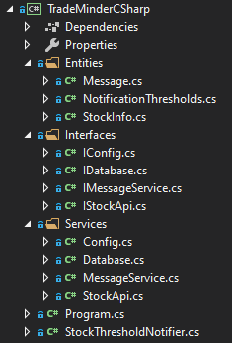
C# Implementation
Solution Layout
StockThresholdNotifier.cs contains the feature workflow.
“IO” dependencies are modeled as “Services”
Each service has an interface to facilitate testability and loose coupling.
See Microsoft Unit Testing Best Practices
Dependencies are injected into feature class constructor and can be substituted with mocks during unit testing.
This is a fairly common architecture that has been used successfully in many projects

Slide 5
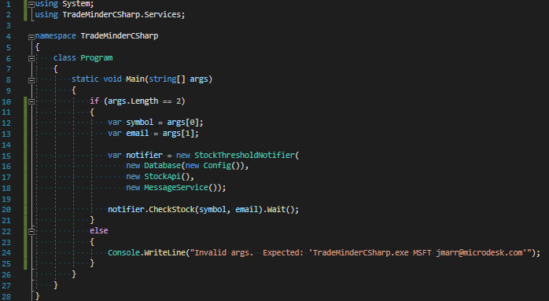
C# - Program.cs
Notes
This is the “composition root”
Dependencies are instantiated and then injected into the feature class.
Some apps use a DI container instead, like Ninject.

Slide 6
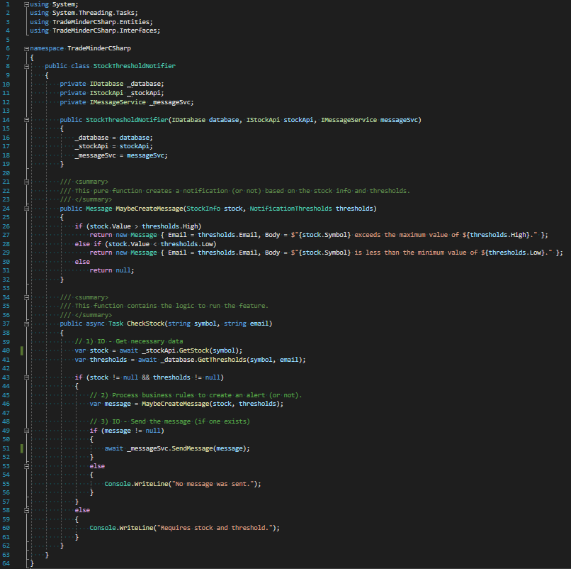
C# - Feature
Notes
Dependencies are c’tor injected
CheckStock “feature” method:
1) Gets input data
2) Applies thresholds (business rules)
3) Sends message (maybe)
This code is fully testable, and can be written and tested before the injected IO dependencies are implemented.

Slide 7
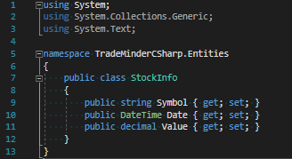
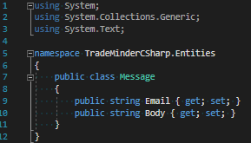
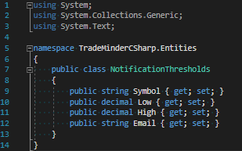
C# - Entities
Notes
NotificationThresholds.cs User defined thresholds that are stored in Sqlite
StockInfo.cs Represents stock price
Message.cs A message is generated only if a stock value is higher the thresholds.High or lower than thresholds.Low.

Slide 8
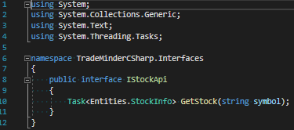
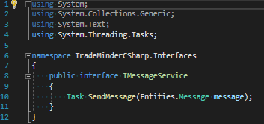
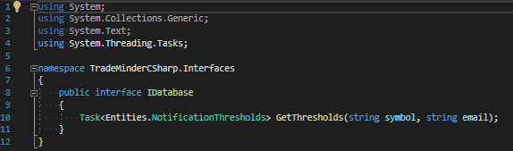
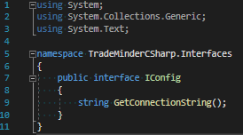
C# - Interfaces
Notes
Interfaces allow us to create "loosely coupled" services.
A.k.a. "design by contract"

Slide 9
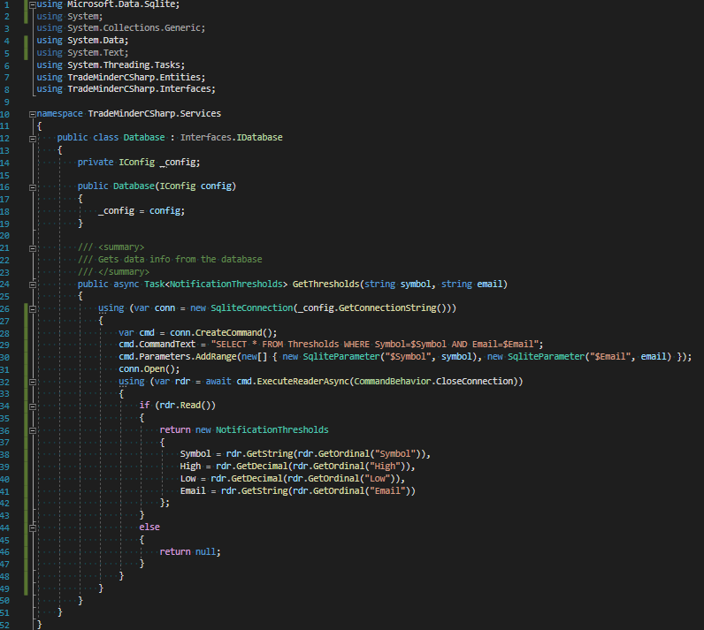
C# - Database
Notes
Connection string info is constructor injected
Basic ADO.NET query
Either returns NotificationThresholds or null
(The seasoned dev should know to check for nulls!)

Slide 10
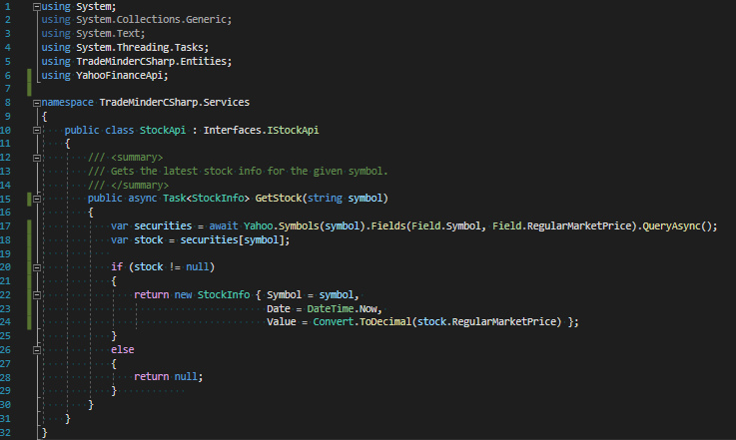
C# - StockApi
Notes
Uses YahooFinanceApi to check stock price
Returns StockInfo or null

Slide 11
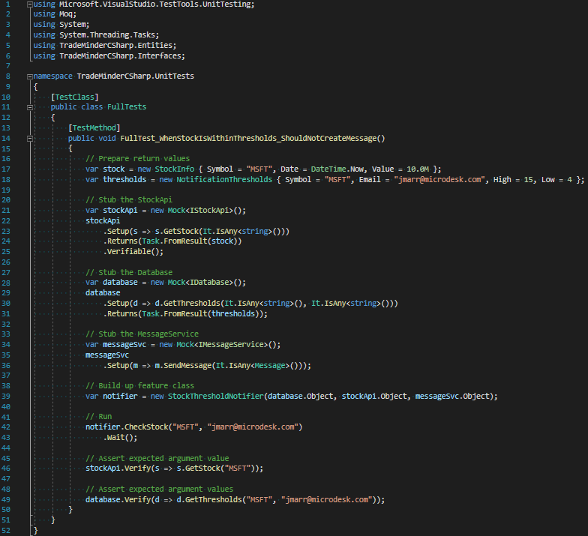
C# - Unit Tests
Notes
Expected IO data is prepared
IO dependencies are mocked using “Moq”.
“Setup” asserts that a method is called
“Returns” specifies a value
“Verify” asserts the value of an argument passed to the dependency interface.
“Verify” must happen after the feature is tested or else it won’t work properly! ☹

Slide 12
F# - “Refactor to Testability”
Goals
To demonstrate how to design the same feature in F#
To show a repeatable “recipe” for refactoring an F# feature to be more testable
To demonstrate how to architect in F# using functions vs. OOP class based design
To show how easy and flexible it is to develop a general purpose app “line-of-business” feature in F#

Slide 13
F# - Progressively Testable Design
Phases
Phase 1: Untestable
IO Dependencies will be called directly from feature (tightly coupled)
A.k.a. “Git ‘er done”
Phase 2: Partially testable
Only the core business logic will be extracted and tested
A.k.a. “Best bang for the buck”
Phase 3: Fully testable
IO Dependencies will be injected
Should be as testable as the C# implementation
A.k.a. “Overkill” ;)

Slide 14
Core Concept: IO and Pure
New Terms
Feature Function – A "transaction script" function that implements the feature.
IO Function – A functions that represent external dependencies
i.e. Databases, APIs, file system, etc.
Pure Function – A pure logic function that doesn’t make any IO calls
Must be passed everything it needs to do its work
Must always return the same output for a given input
These are very easy to test

Slide 15
Core Concept: IO -> pure -> IO
Architectural Concept
Feature = “IO -> pure -> IO”
A.k.a. “IO Pure Sandwich”
A.k.a. “Functional Core, Imperative Shell”
You should always start by identifying which operations in your feature are “IO” and which can be “pure” (calculations / transformations on data).
Step 1) Get the IO data required
Step 2) Pass it into the pure functions
Step 3) Do any final IO (saving to database, file system, messaging, etc).

Slide 16
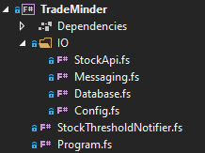
F# Implementation
Solution Layout
IO dependencies will go in the "IO" folder
The "StockThresholdNotifier" module will contain the Feature function itself (a transaction script)
The entities are all declared within their respective modules
Alternatively, you could also declare them all together in one file at the top, i.e. "Entities.fs".
Program.fs contains the "main" launch function.
F# files are order dependent, so Program.fs is always last, despite the fact that "P" comes before "S".

Slide 17
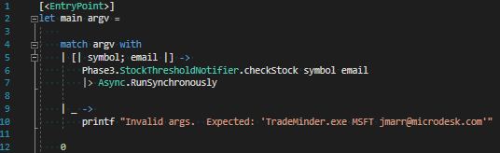
F# - Program.fs
Notes
Pattern match to destructure args array
Async.RunSynchronously is like C# Task “.Wait()”
F# has it’s own built-in async library that can be used with C# TPL Tasks.

Slide 18
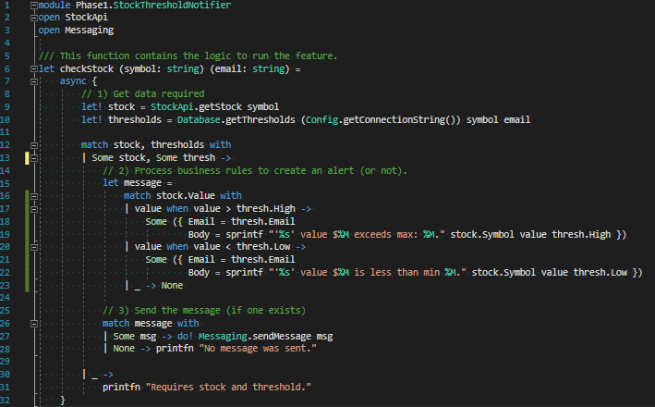
F# - Phase 1: StockThresholdNotifier.fs
Notes
“checkStock” models the feature as a function.
Not unit testable
Sometimes that’s okay!
Tightly coupled IO dependencies
async block (C.E.)
let! (“let bang”) is like C# “await”
Note: Code is factored into “IO -> pure -> IO”
This will make it easier to “refactor to testability”

Slide 19
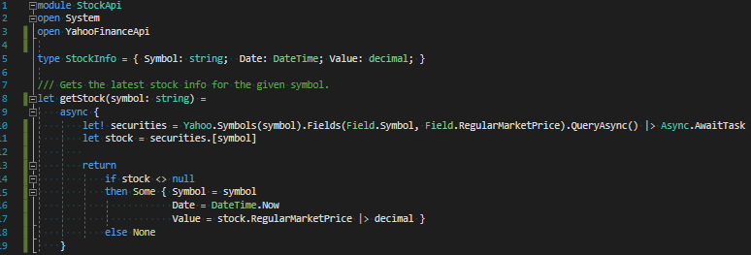
F# - IO: StockApi.fs
Notes
Entities are commonly modeled alongside related functions.
Uses YahooFinanceApi
Returns Some StockInfo or None
Uses “async” expression
Unlike regular functions, Computation Expressions use the “return” keyword.
Async.await converts TPL Task to F# Async
There is also a “task” C.E.

Slide 20
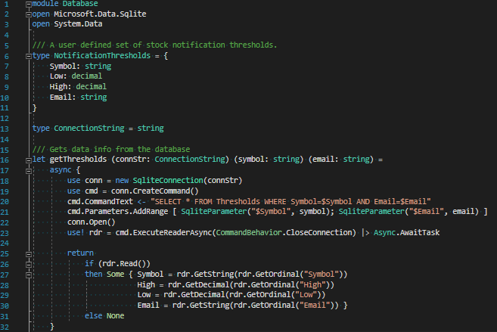
F# - IO: Database.fs
Notes
NotificationThresholds entity declared in module alongside “getThresholds” function
ConnectionString is just type “alias” for string
“connStr” is a dependency this function needs.
Dependency args should always be passed in first! (you’ll see why later).
Returns Some Thresholds or None
This means that compiler will force caller to “unwrap” optional value and handle both cases

Slide 21
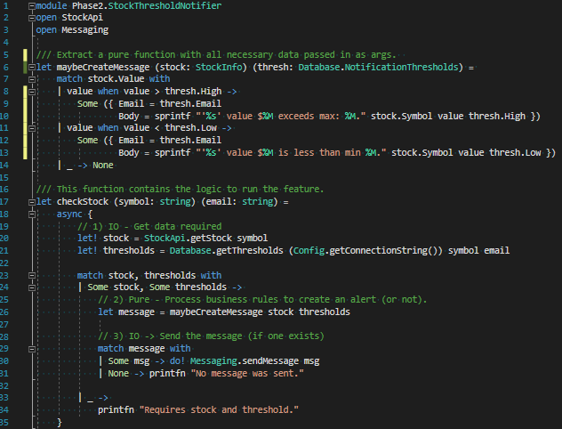
F# - Phase 2
Notes
Refactor to testability: Extract processing logic into a “pure” (testable) function.
IO functions are still tightly coupled, but do we really need to test those?
I say no, because there is no branching logic around the IO (low “cyclomatic complexity”).
Benefit:
Business logic is easily tested
Code remains simple
No interfaces or mocking required
IO -> pure -> IO makes for easy testing of pure logic
“Best bang for the buck”

Slide 22
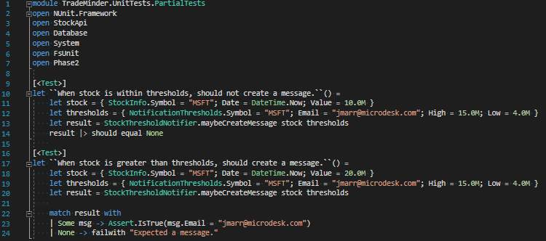
F# - Phase 2: Testing a Pure Function
Notes
Double ticks make for nice test names
No mocking/stubbing required because pure functions are passed the data they need.

Slide 23
F# - Phase 3
Make it fully testable!
In Phase 2, we extracted only the business logic to make it testable.
In Phase 3, we want our feature function to no longer be "tightly coupled" to the IO implementations.
Instead, we want to inject the IO functions to allow us to pass in mocked implementations, like the fully testable C# example.

Slide 24
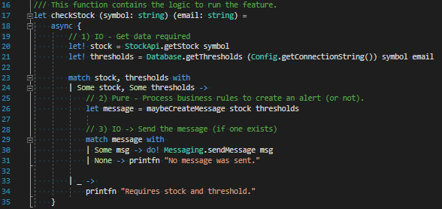
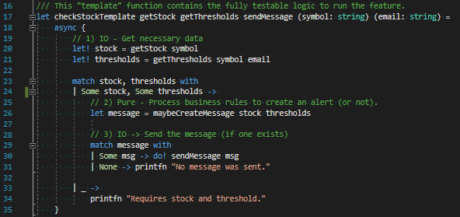

F# - Phase 2 –> Phase 3 Refactor
1) Create a Template “higher order function”
2) Pass in IO functions as dependencies (using F# Type Inference)
3) Replace tightly coupled IO calls with loosely coupled injected functions
4) Recreate the feature function as a partially applied version of the template
Phase 2
Phase 3 (Extract to Template)

Slide 25
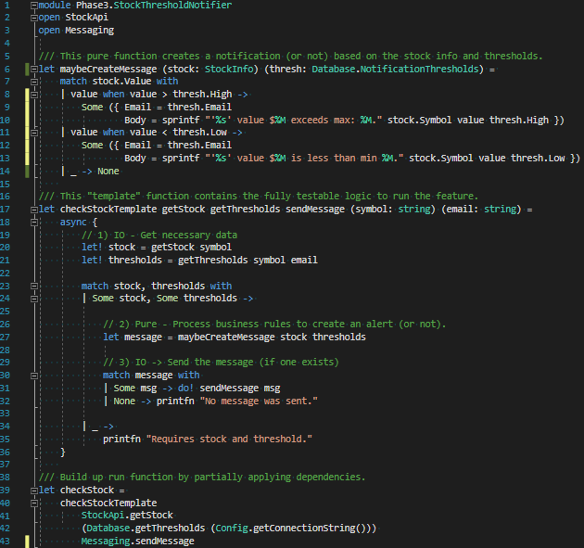
F# - Phase 3
Notes
I call it a template because it’s like the GoF “Template” pattern.
Abstract class with a series of steps as abstract methods that are chained together in an implementation method.
Concrete classes simply implement the steps.
checkStockTemplate is a “higher order function” that takes IO dependency functions as args (along with the original args).
Dependency arguments (i.e. things that would be c’tor injected in C#) should always be modeled first.
The new checkStock function “builds up” the template function by partially applying the IO dependencies.
IO Dependencies in the template can be substituted in unit tests.
Fully Testable! (equivalent to C# sample)

Slide 26
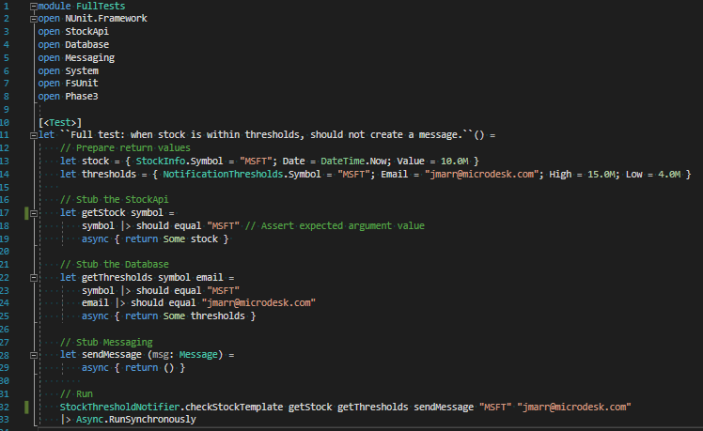
F# - Phase 3 – Full Unit Testing
Notes
IO dependency functions can easily be modeled as functions
no mocking framework required
Testing the input args of dependencies is also very straight forward

Slide 27
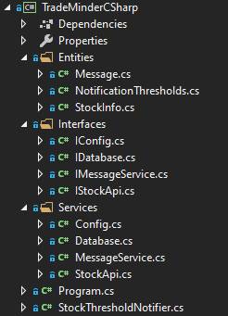
Side-by-side: Solution Layout
C#
F#
Entities are often 1-file-per-class
Interfaces are necessary for testability; and they are often used even if no tests are written to adhere to best practices (loose coupling).
Files listed in ABC order
Entities often live in modules alongside functions
Interfaces are never needed for testability or loose coupling.
Files are order dependent

Slide 28
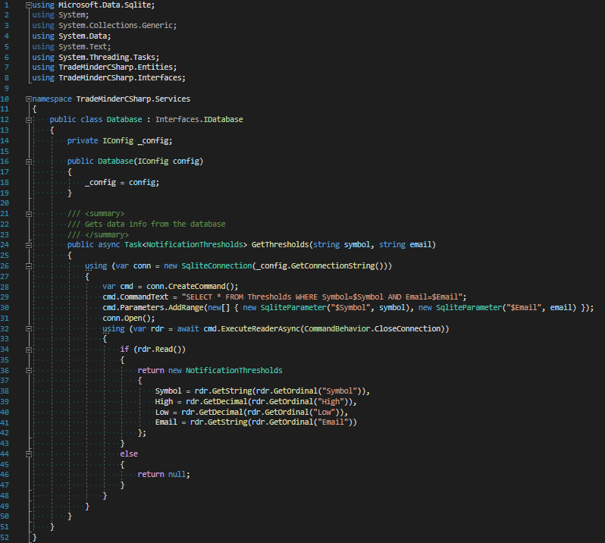
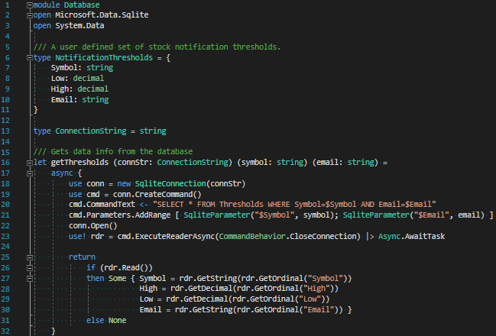
Side-by-side: Database
C# - Database.cs
F# - Database.fs

Slide 29
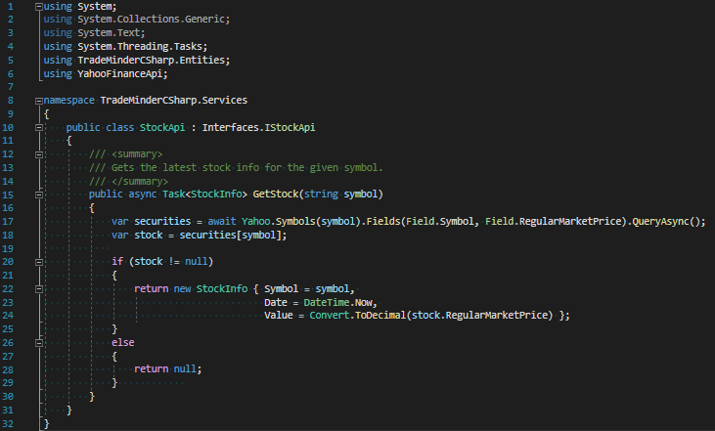
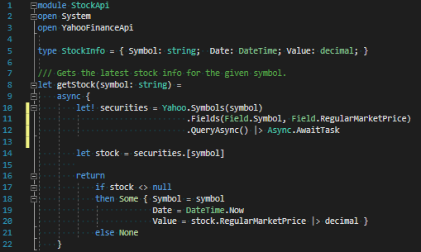
Side-by-side: StockApi
C#: StockApi.cs
F#: StockApi.fs

Slide 30
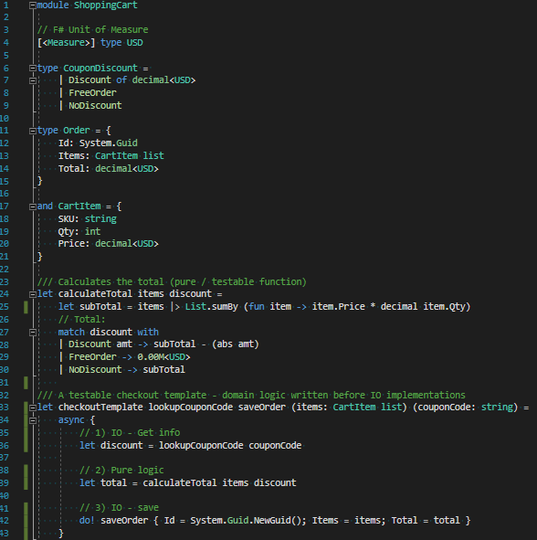
BONUS: Domain Driven Design
Skip to Phase 3 (a.k.a. DDD)
Domain Driven Design / TDD
Develop domain entities and business logic first without worrying about implementation details
“Exploratory Coding” – Great for when you just got off a call discussing a new project, and you want to flesh out the core logic.
I like to annotate simple args (items and couponCode), and only use type inference for function signatures.
Type inferred args are kind of like “putty” in that they conform to whatever is pressed up against them on either side!
When IO is implemented, you can create a “checkout” function that builds up the “checkoutTemplate” using partial application.

Slide 31
</>

